Slide 1

Shadow prediction: SQL 2014 spatial data types and astronomy well mixed
Notes:
…

Slide 2
Agenda
Whoami
Motivation
Examples
How to model?
What is needed?
Demo1: Drawing circles or Introduction to spacial datatypes
Tools 1: Tilt of coordinate system/spherical trigonometry
Demo2: Paint the sun in the sky
Tools 2: Azimuth, altitude, size
Demo3: Add the turbine(s)
Bonus : Astronomy, precise to the second

Slide 3
Whoami
Arne Bartels
Working for Vestas Windsystems A/S in Aarhus DK. Since approx. 2007 as Data Warehouse Developer
Software developer in wind industry since 2001
Physicist by training, programmer by profession
Worked in C/C++,Pascal,Linux scripts/PHP, MySQL…
Recent: T-SQL, SSIS, C#
arbar@vestas.com
arne.bartels2@gmail.com

Slide 4
Motivation
Inspired by real world challenge
Encourage to use unusal combination of methods
Introduce spatial data types i.e. GEOGRAPHY
A shift of perspective might give new ideas
Show what Management Studio/SQLServer can do
Show off what I can do
Notes:
Next Rapid prototyping

Slide 5
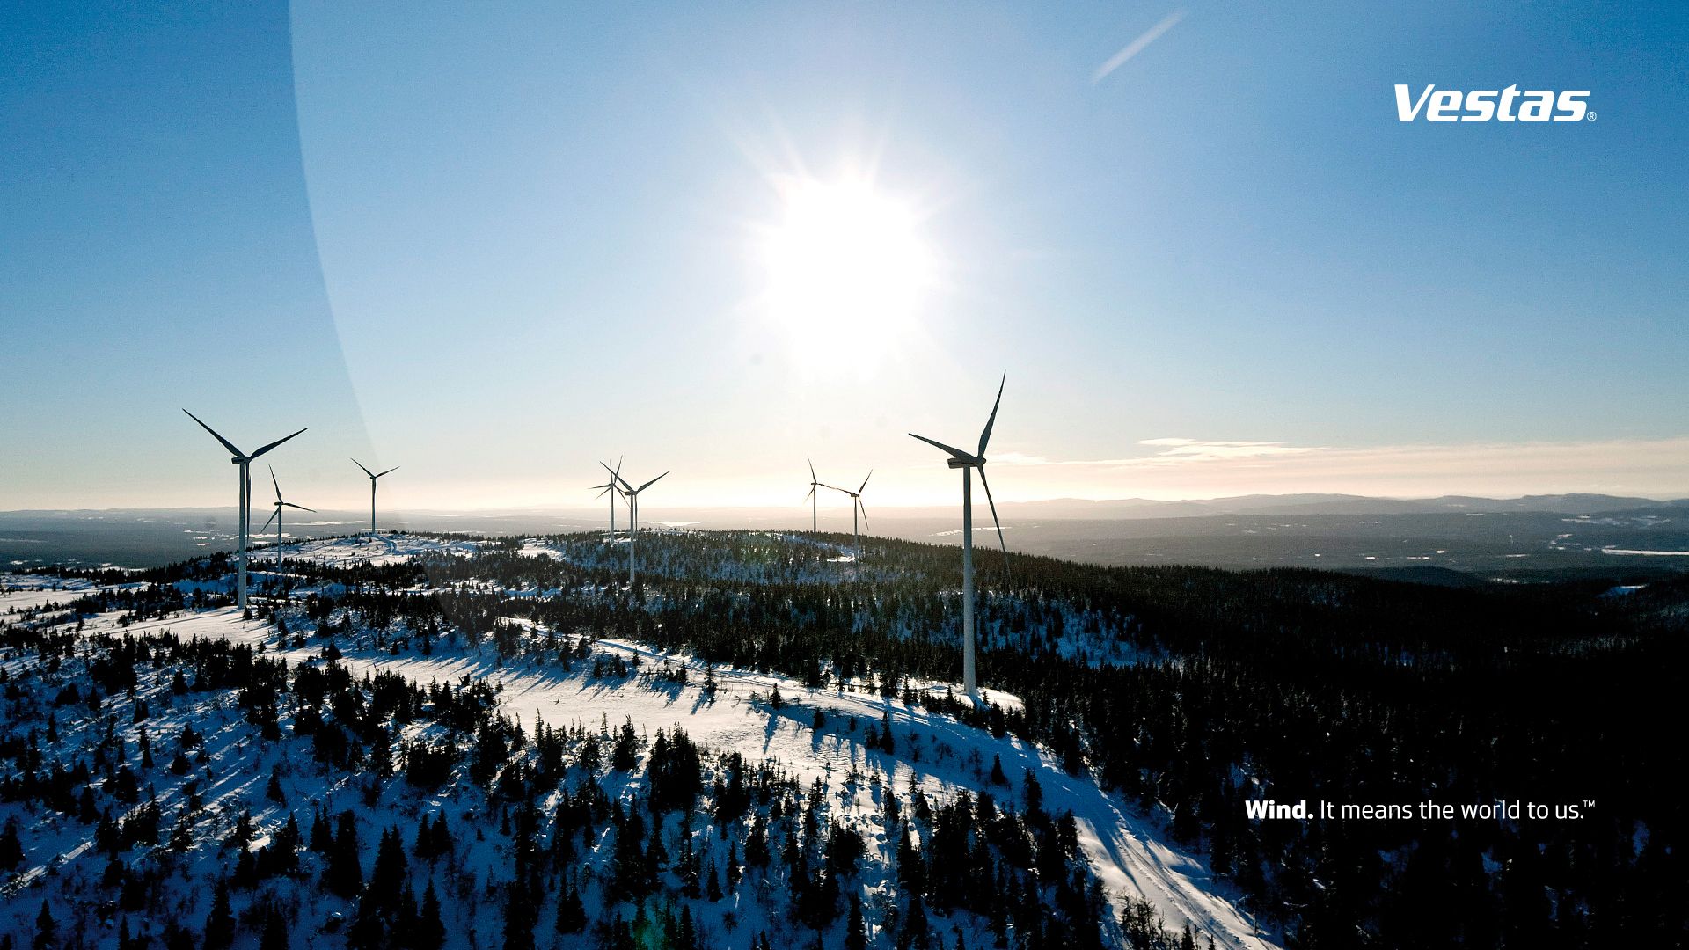
Tauernwind

Slide 6
How to model?
Assume worst case i.e. turbine is always pointed in the sun, then the turbine can be modeled as a sphere on top of the tower. The radius is the blade length or a bit more.
The house in the shadow can be encompassed by a circle where no shadow is allowed.
Then the sensitive areas can be projected as circles in the sphere, that represents the sky seen from the house
Compare to path of the sun seen from the house
=> simple drawings of circles with GEOGRAPHY are usable

Slide 7
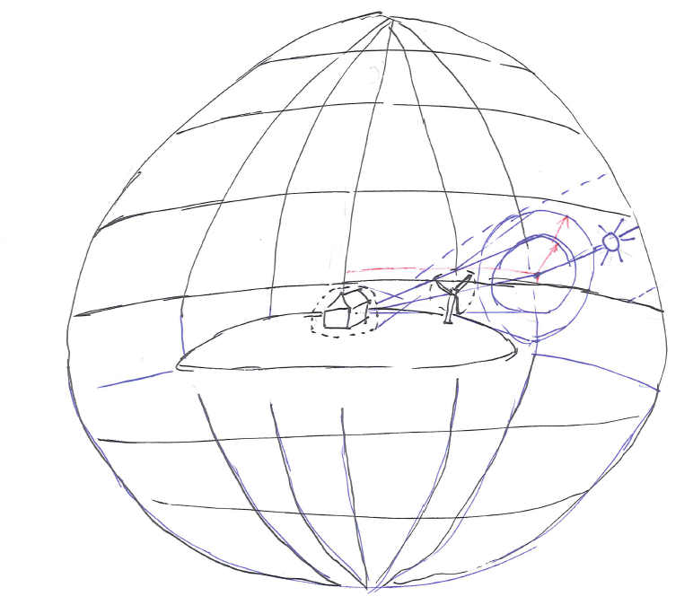
What is needed?
Path of the sun -> formulas known for ages
Turbine picture in the sky -> basic (?) geometry

Slide 8
Demo1: Drawing circles or Introduction to spatial datatypes
Goal: introduce the necessary datatypes and operators
Necessary tools:
Minimum SQL2012, here 2014
SQL Management studio
Any Database, here : AdventureworksDW2014
Imagination…
Notes:
Demo 1

Slide 9
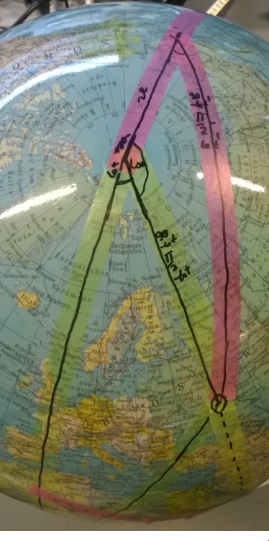
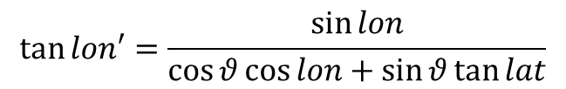
Tools 1: Tilt of coordinate system/spherical geometry
There seem to no way to move GEOGRAPHY elements in SQL directly. Possible solution: parse as XML, recalculate and recreate.
How do lat and lon change if we tilt by angle ϑ?
Believe me, check here for yourself, or look in the appendix
$$\sin{lat^{′}=\cos{θ\sin{lat−\sin{θ\cos{lat}\cos{lon}}}}}$$
$$\tan{lon′}=\frac{\sin{lon}}{\cos{θ}\cos{lon+\sin{θ\tan{lat}}}}$$

Slide 10
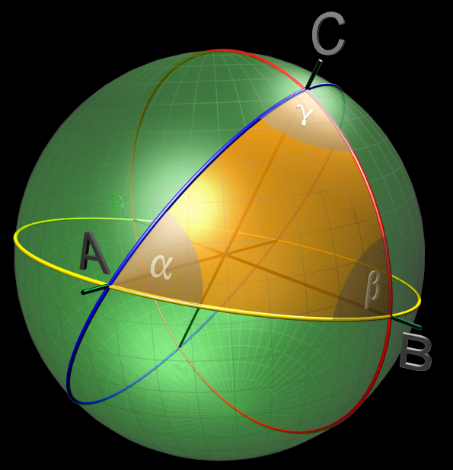
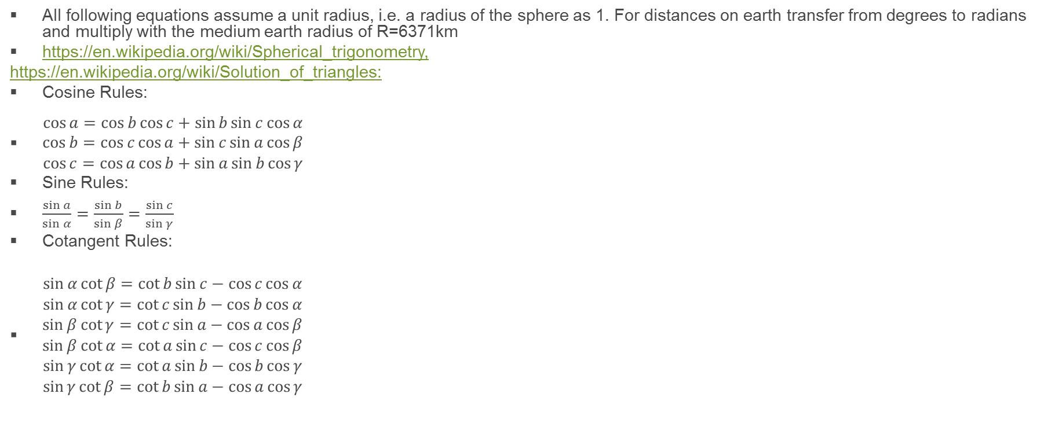
Tools: Spherical Trigonometry
All following equations assume a unit radius, i.e. a radius of the sphere as 1. For distances on earth transfer from degrees to radians and multiply with the medium earth radius of R=6371km
https://en.wikipedia.org/wiki/Spherical_trigonometry,
https://en.wikipedia.org/wiki/Solution_of_triangles:
Cosine Rules:
$\begin{matrix}\cos{a}=\cos{b}\cos{c}+\sin{b}\sin{c}\cos{α} \\ \cos{b}=\cos{c}\cos{a}+\sin{c}\sin{a}\cos{β} \\ \cos{c}=\cos{a}\cos{b}+\sin{a}\sin{b}\cos{γ}\end{matrix}$
Sine Rules:
$\frac{\sin{a}}{\sin{α}}=\frac{\sin{b}}{\sin{β}}=\frac{\sin{c}}{\sin{γ}}$
Cotangent Rules:
$\begin{matrix}\sin{α}\cot{β}=\cot{b}\sin{c}−\cos{c}\cos{α} \\ \sin{α}\cot{γ}=\cot{c}\sin{b}−\cos{b}\cos{α} \\ \sin{β}\cot{γ}=\cot{c}\sin{a}−\cos{a}\cos{β} \\ \sin{β}\cot{α}=\cot{a}\sin{c}−\cos{c}\cos{β} \\ \sin{γ}\cot{α}=\cot{a}\sin{b}−\cos{b}\cos{γ} \\ \sin{γ}\cot{β}=\cot{b}\sin{a}−\cos{a}\cos{γ}\end{matrix}$

Slide 11
Demo 2: Paint the sun in the sky
Goal:
Model the sun’s area in the sky for different latitudes
Subtract the part obscured by the ground, aka night
https://en.wikipedia.org/wiki/Equinox
Notes:
Demo 2

Slide 12
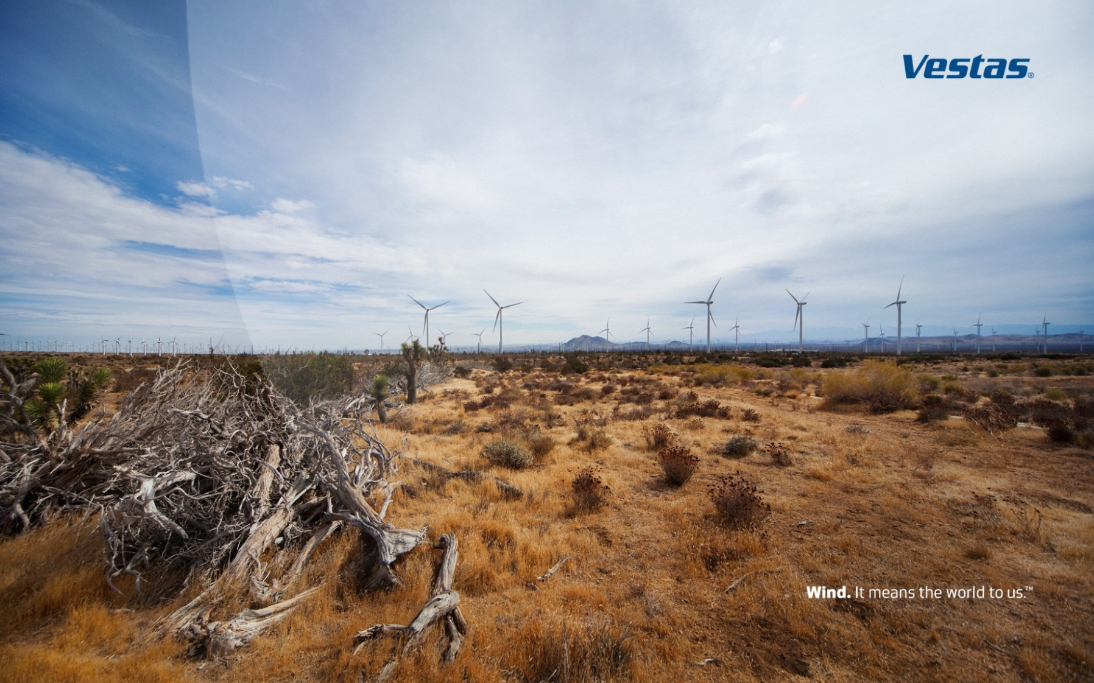

Slide 13
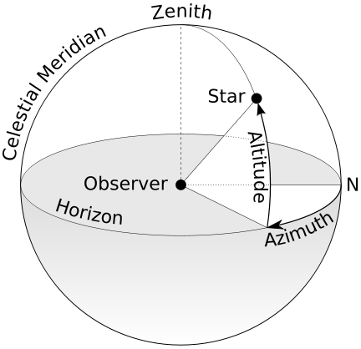
Tools 2: Azimuth, altitude, size
https://en.wikipedia.org/wiki/Horizontal_coordinate_system
https://en.wikipedia.org/wiki/Horizon

Slide 14
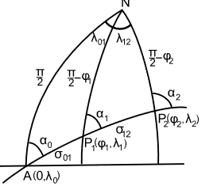
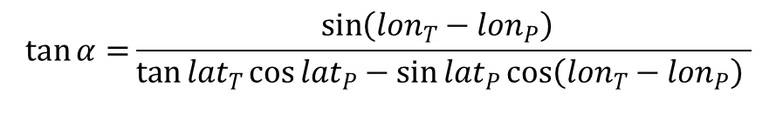
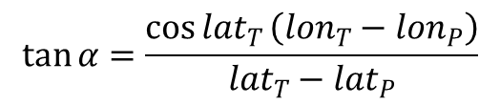
Azimuth
$$\tan{α=}\frac{\sin\left({lon}_{T}−{lon}_{P}\right){ }}{\tan{{lat}_{T}}\cos{{lat}_{P}−\sin{{lat}_{P}\cos\left({lon}_{T}−{lon}_{P}\right) }}}$$
Precise solution:
Short distance approximation:
$$\tan{α=\frac{\cos{{lat}_{T}}\left({lon}_{T}−{lon}_{P}\right)}{{lat}_{T}−{lat}_{P}}}$$

Slide 15
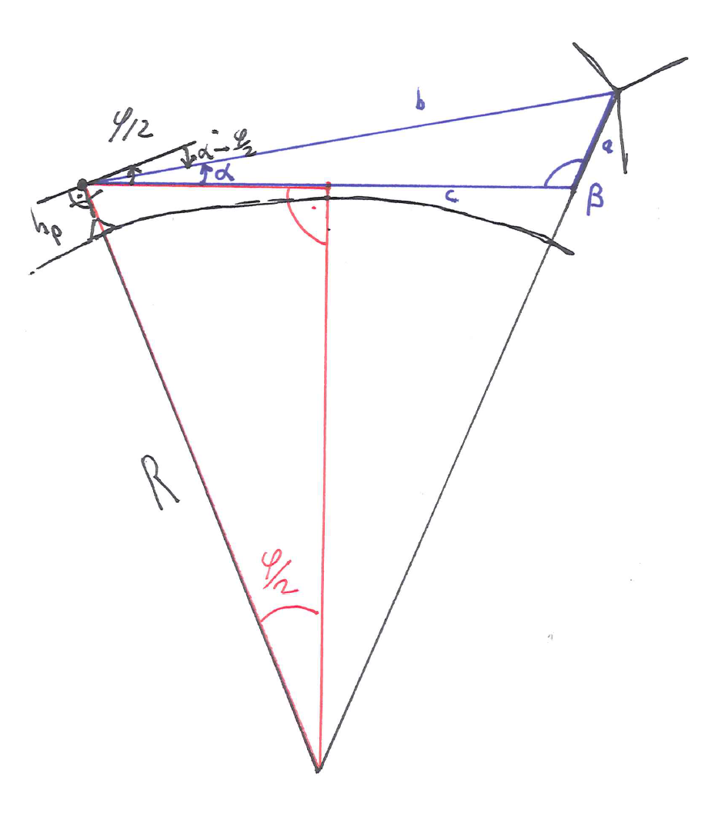
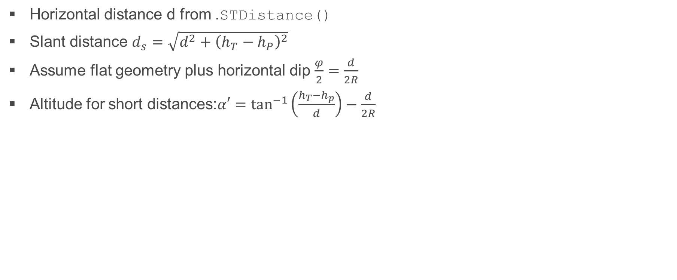
Altitude
Horizontal distance d from .STDistance()
Slant distance $d_{s}=\sqrt{d^{2}+{\left(h_{T}−h_{P}\right)}^{2}}$
Assume flat geometry plus horizontal dip $\frac{φ}{2}=\frac{d}{2R}$
Altitude for short distances:$α′=\tan^{−1}\left(\frac{h_{T}−h_{p}}{d}\right)−\frac{d}{2R}$

Slide 16
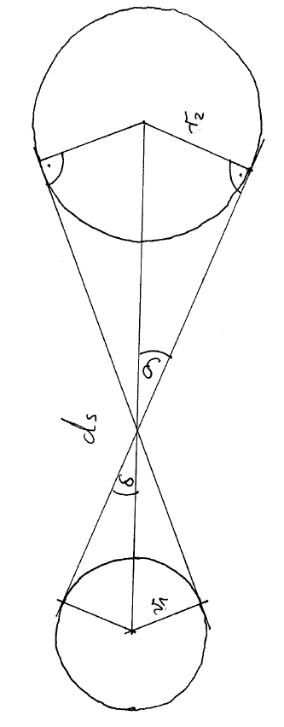
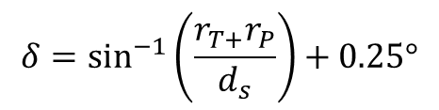
Width
Add both radiuses
Add sun radius full or partially
$$δ=\sin^{−1}\left(\frac{r_{T+}r_{P}}{d_{s}}\right)+0.25°$$

Slide 17
Demo 3: Add the turbine(s)
Refshaleøen
Around the corner
Microsoft Danmark Aps
Lille Havfrue

Slide 18
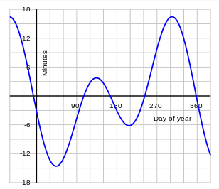
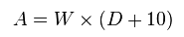
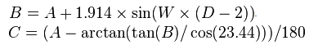
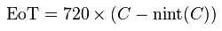
Bonus : Astronomy, precise to the second
https://en.wikipedia.org/wiki/Position_of_the_Sun
https://en.wikipedia.org/wiki/Equation_of_time

Slide 19
















Say thank you to our Sponsors :

Slide 20
Stick around for RAFFLE and the AFTER EVENT!
All our volunteers and organisers do not get paid for organizing this event – If you see them, please:
Give them a hug
Shake their hand
Say thank you
Spread the word
Get involved yourself
Don’t forget to thank the sponsors for their support
Thank the speakers for donating their time, energy and expenses

